Slide 1
The Effect of Pro Sports teams on a City’s Economy
By Jae Hyun Lee, Jordan Bales, Ben Rogers

Slide 2
Executive Summary
Does a city having a sports team affect its GDP?
Does market size matter to economic impact?
Does a city purchasing or relocating a sports team affect its GDP?

Slide 3
Data Summary
Data from Bureau of Economic Analysis, Forbes, Sports Reference, ESPN
Mixture of scrapped, CSV, and manually imputed

Slide 4
Data Summary
Data from 24 cities from 2001 to 2018
6 Large Market, 6 Medium Market
6 Small Market, 6 No Teams
96 total variables

Slide 5
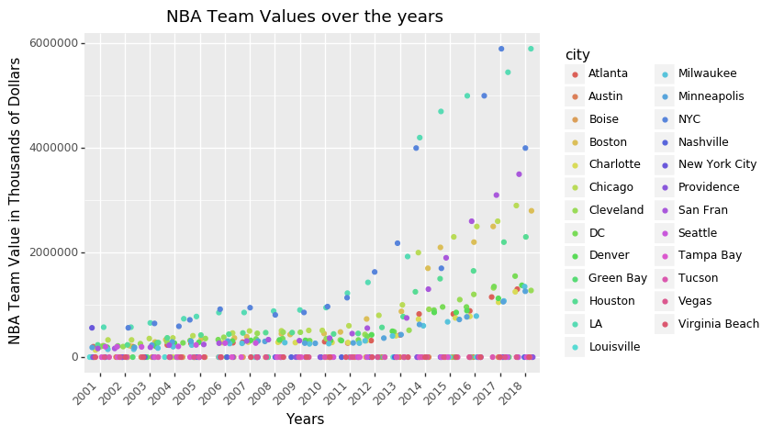

Slide 6
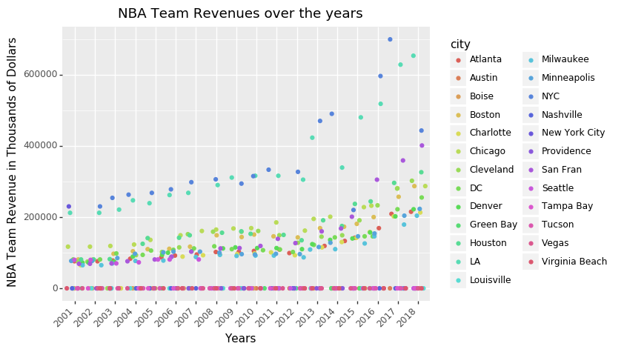

Slide 7
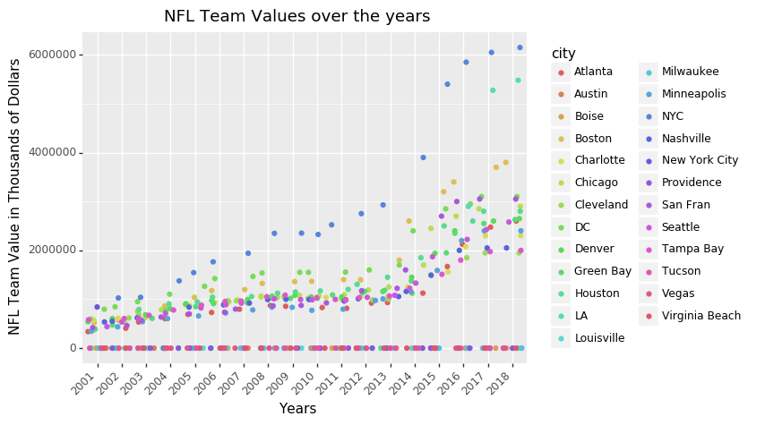

Slide 8
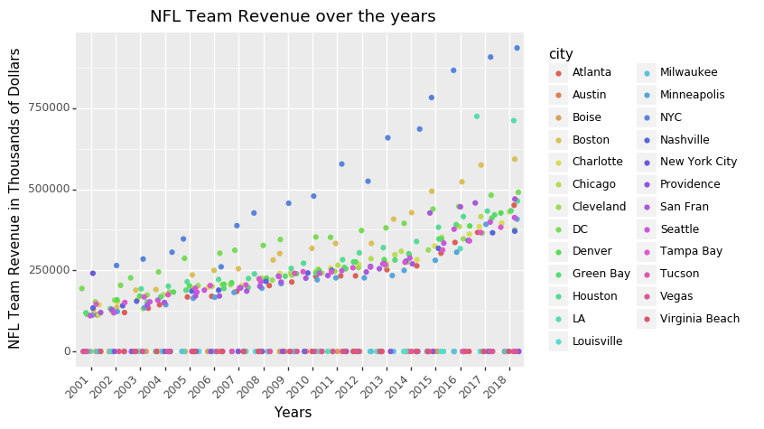

Slide 9
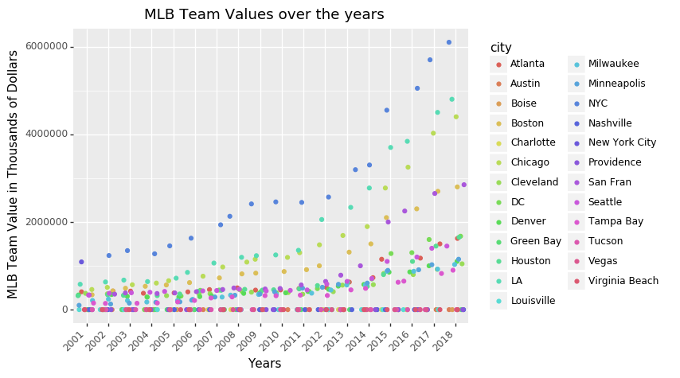

Slide 10
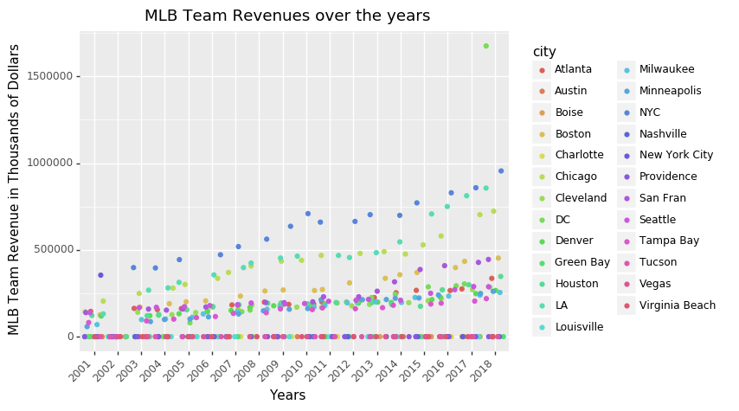

Slide 11
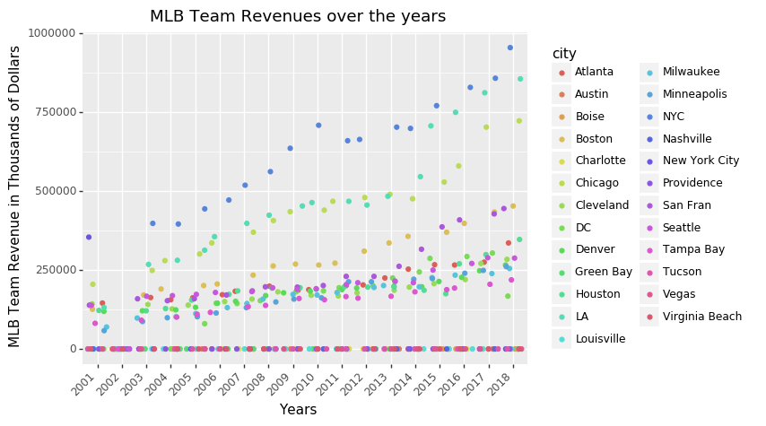

Slide 12
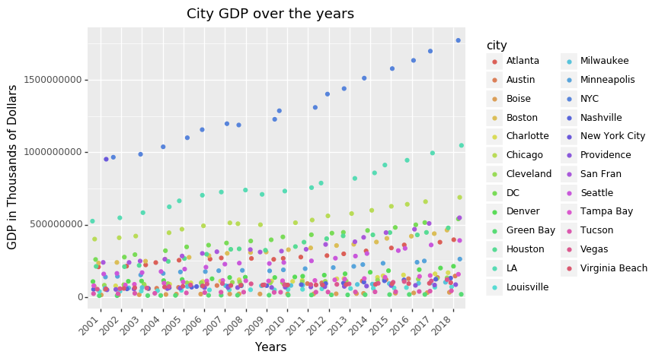

Slide 13
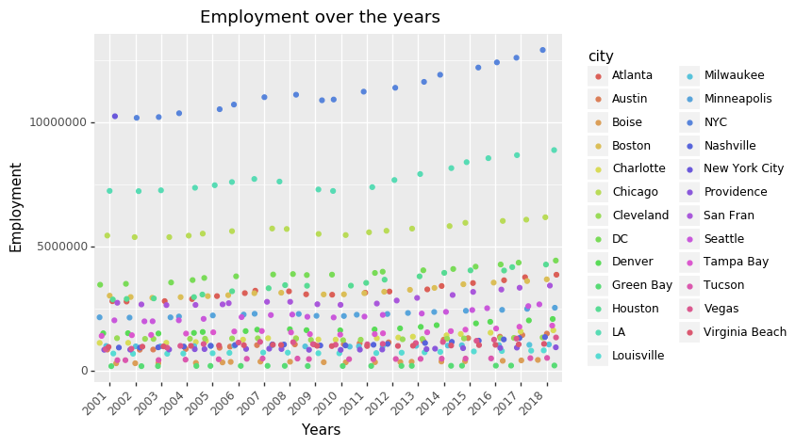

Slide 14
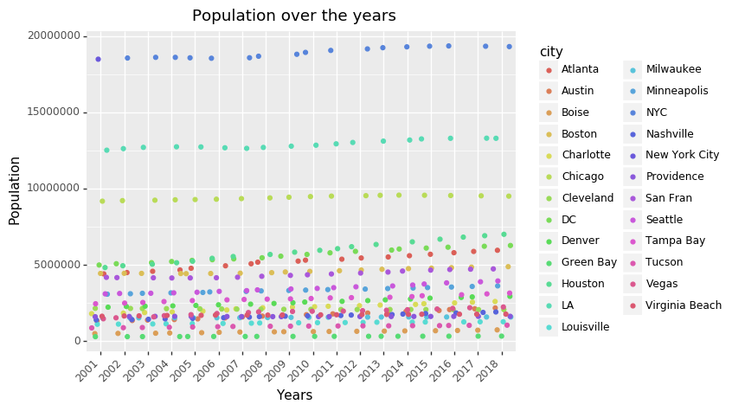

Slide 15
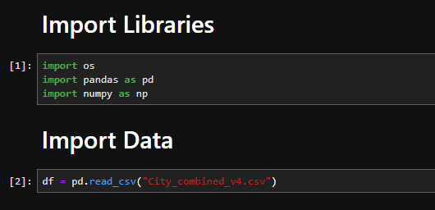
Variable Transformation and Preprocessing
Notes:
We began with importing libraries such as pandas and Numpy and we also imported the csv file and started with a pandas dataframe.

Slide 16
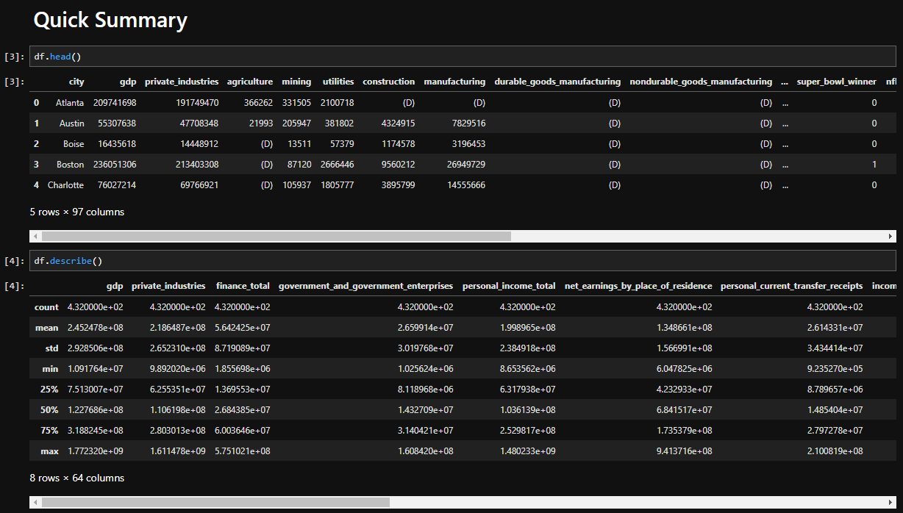
Variable Transformation and Preprocessing
Notes:
We generated a quick summary of the imported csv file to validate column names and spot any missing values

Slide 17
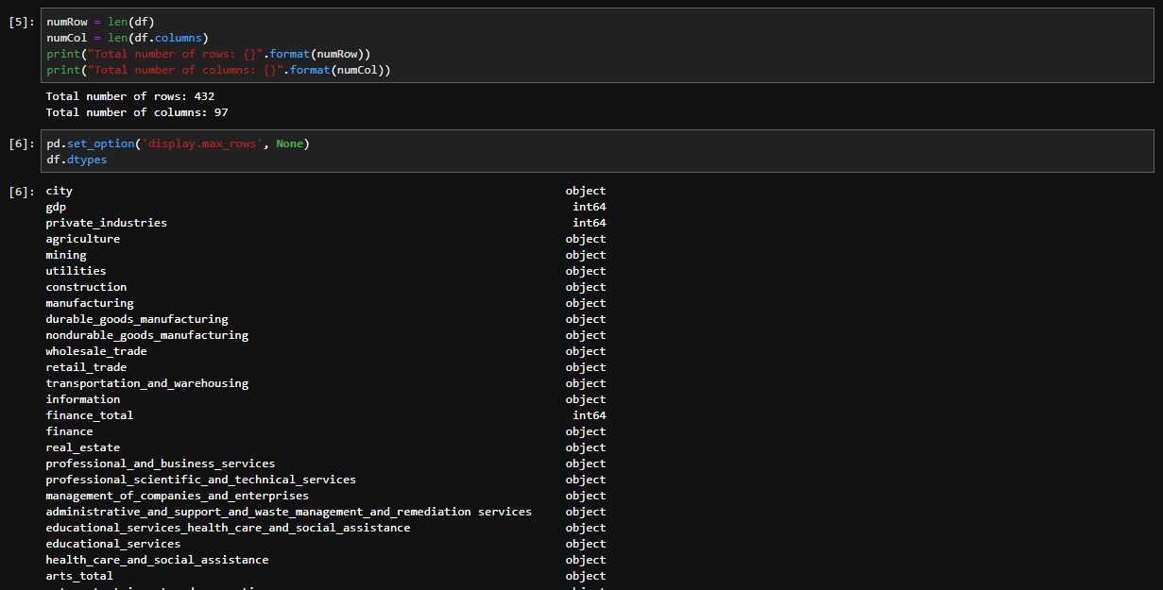
Variable Transformation and Preprocessing
Notes:
We got a total number of rows and columns and check dtypes of each column.

Slide 18
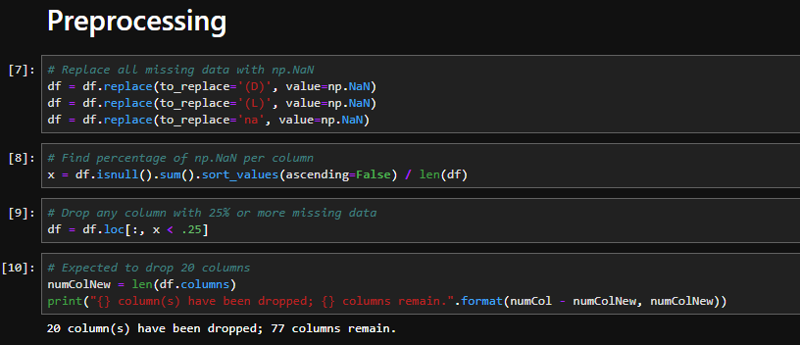
Variable Transformation and Preprocessing
Notes:
After a quick analysis on what we have, we replaced missing values with Numpy null values and found the percentage of null values per column.
Then we dropped any column that’s missing data by 25% or more, which resulted in 20 less columns than what we started with.

Slide 19
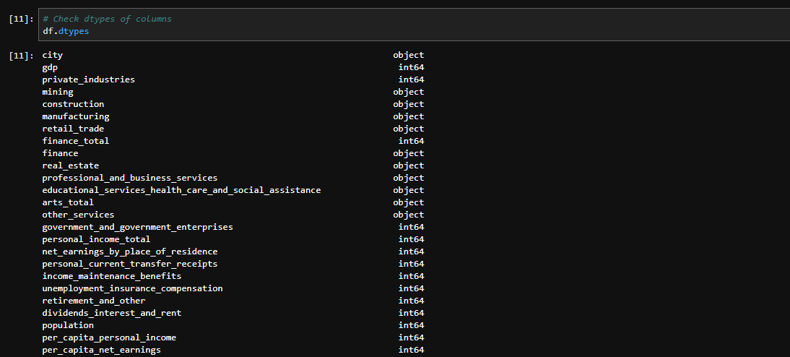
Variable Transformation and Preprocessing
Notes:
Next, we went back to the dtypes and noticed some of the columns are read as ‘object’ instead of ‘int’ or ‘float’.
This was probably because any missing data was initially represented as a string, such as ‘(D)’ or ‘na’.

Slide 20
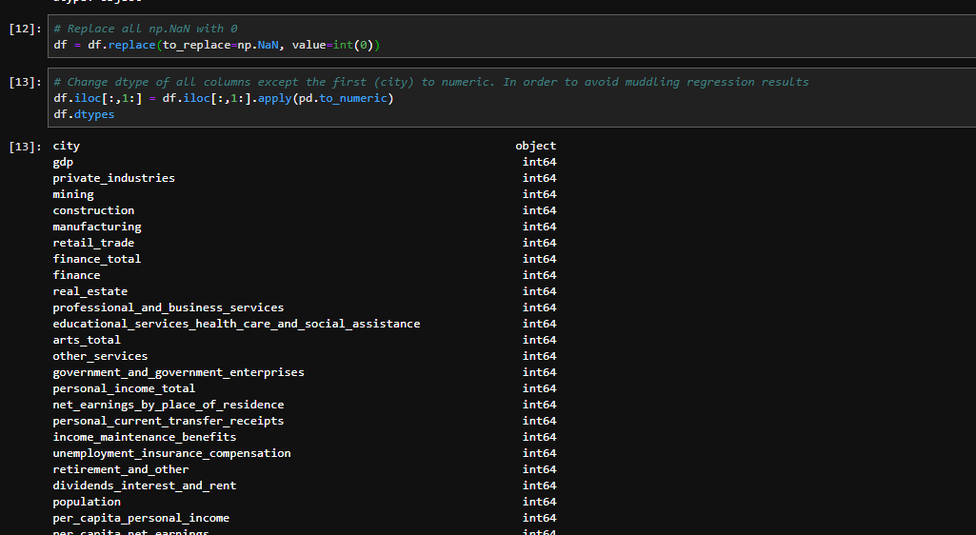
Variable Transformation and Preprocessing
Notes:
We replaced all null values with 0 and updated all non-numeric columns to numeric, except the first column, which is city names.

Slide 21
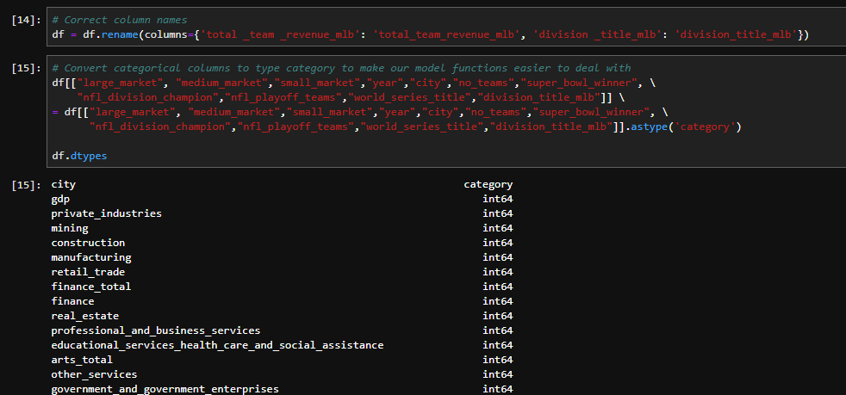
Variable Transformation and Preprocessing
Notes:
We fixed a few column names and converted dtypes of some categorical columns, such as year or ‘super_bowl_winner’ and market size columns that have a value of either 0 or 1.

Slide 22
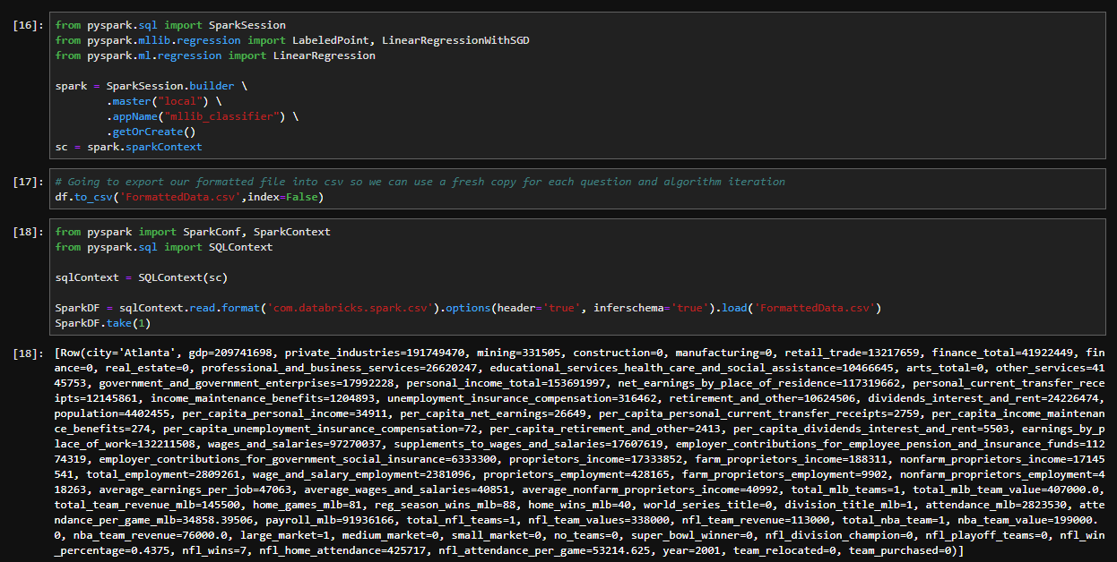
Models Constructed
Notes:
We started our model construction process with linear regression.
After importing spark libraries we exported our preprocessed pandas dataframe and converted it to a spark dataframe.

Slide 23
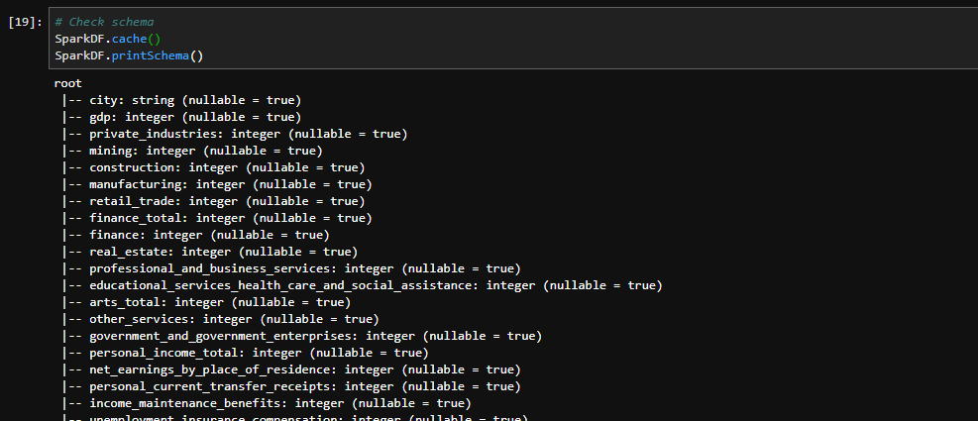
Models Constructed
Notes:
We checked the schema of the spark dataframe to make sure everything is correct so far.

Slide 24
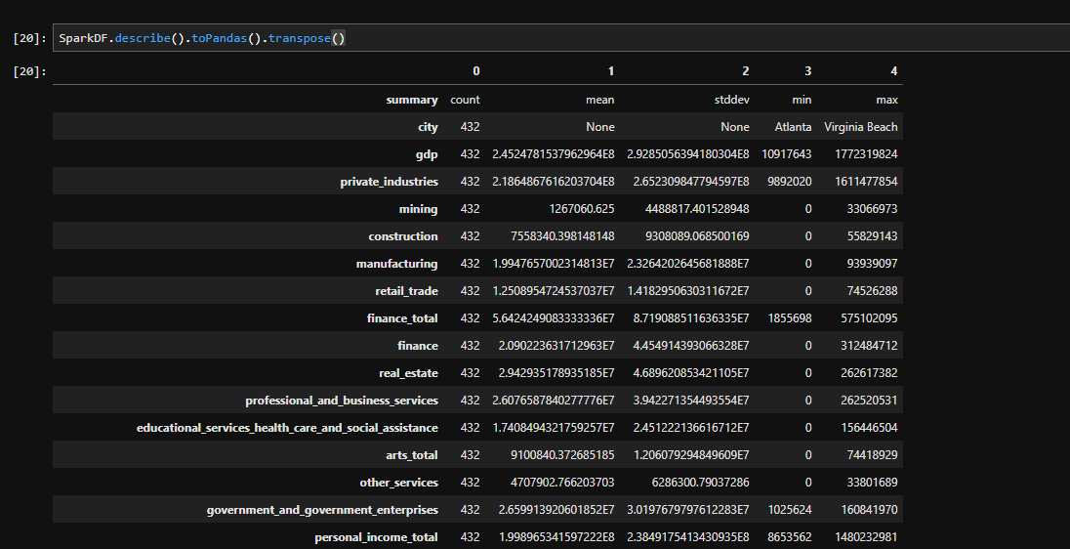
Models Constructed

Slide 25
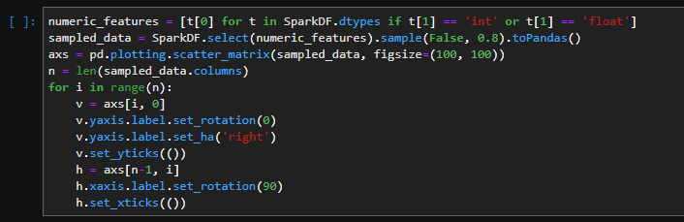
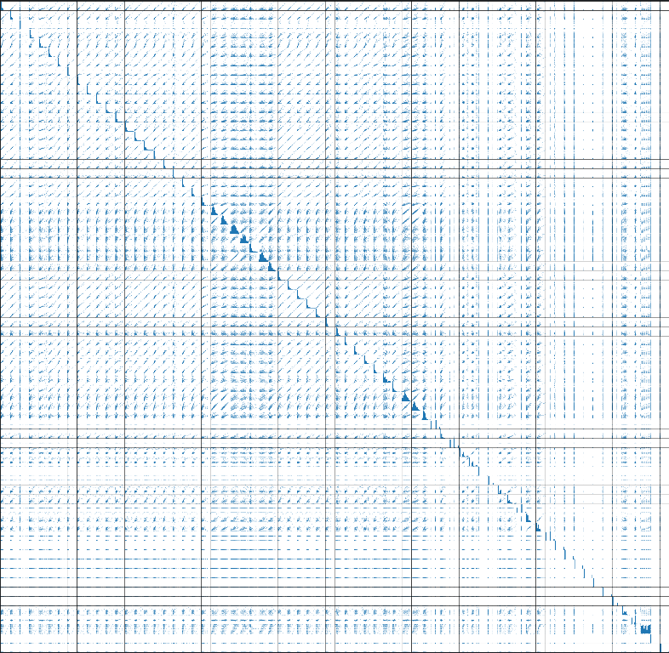
Models Constructed
Notes:
We first looked at the scatter matrix, which wasn’t really helpful due to the sheer volume of the columns we have.

Slide 26
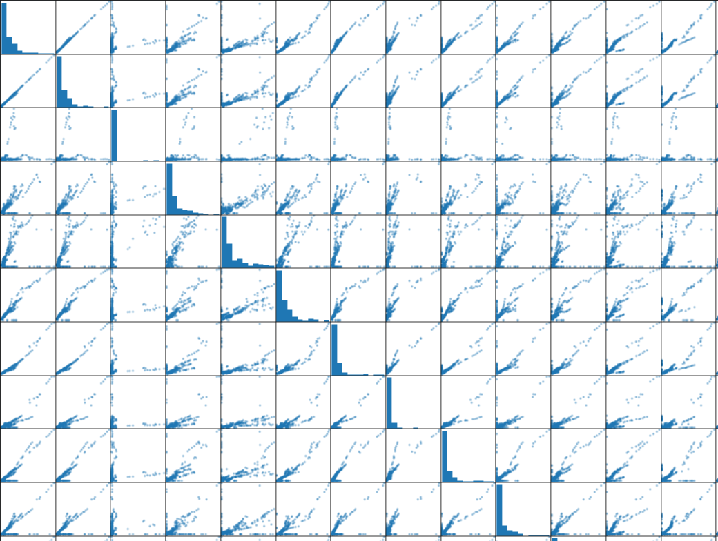
Models Constructed
Notes:
A portion of enlarged image of the scatter matrix.

Slide 27
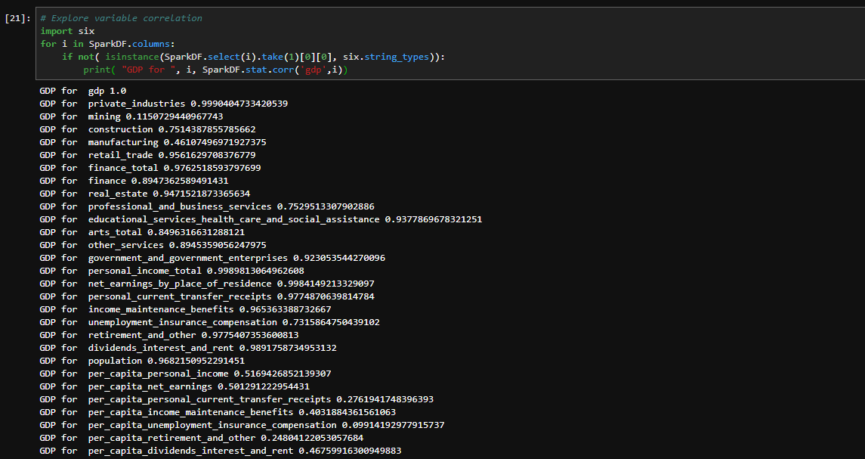
Models Constructed
Notes:
From there we decided to explore correlation of variables against GDP only.

Slide 28
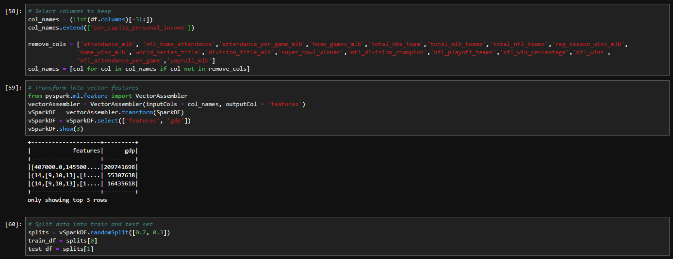
Models Constructed
Notes:
Based on these studies we selected which columns to keep and split the data into train and test set by 70% and 30%, respectively.

Slide 29
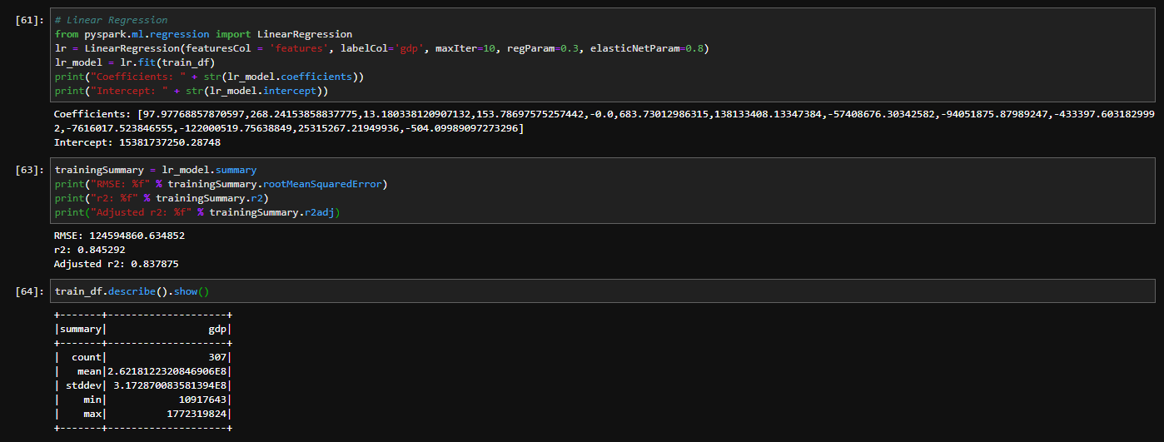
Models Constructed
Notes:
Then we trained a linear regression model. This particular model had adjusted R-squared of 0.84.
<This means approximately 84% of the variability in GDP can be explained using the model.>

Slide 30
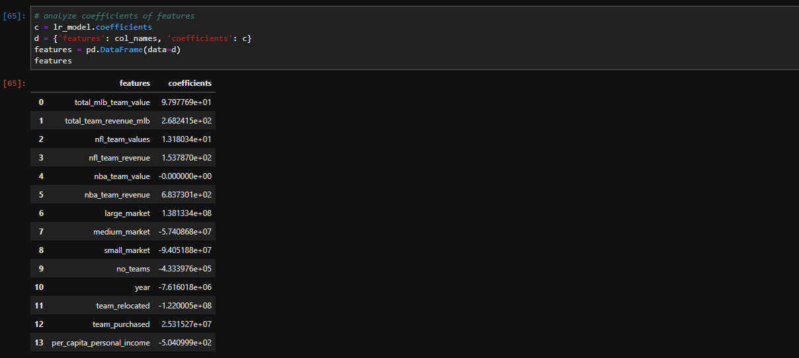
Models Constructed
Notes:
We studied the coefficients of the features to see polarity and magnitude of each variable

Slide 31
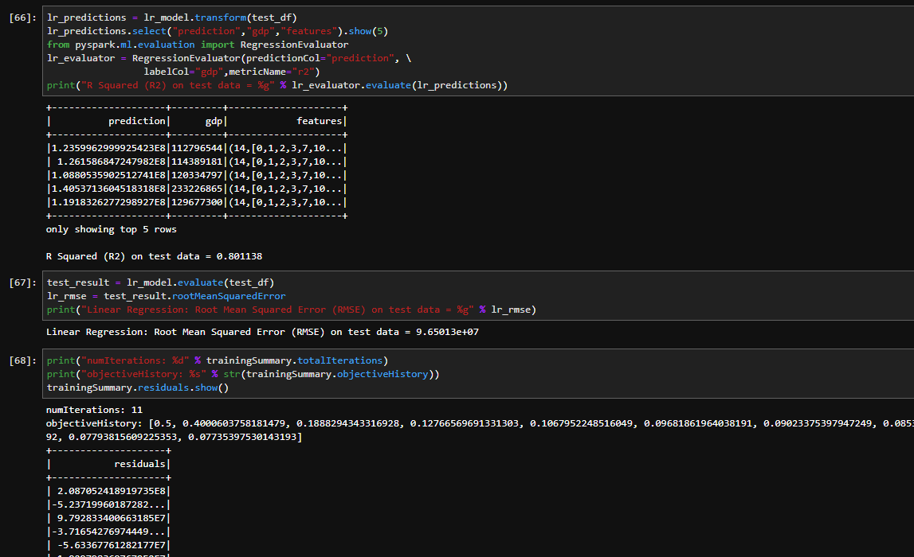
Models Constructed
Notes:
We tested the model and got R-squared of 0.80. This is slightly lower than what we got from the training model, which is expected.

Slide 32
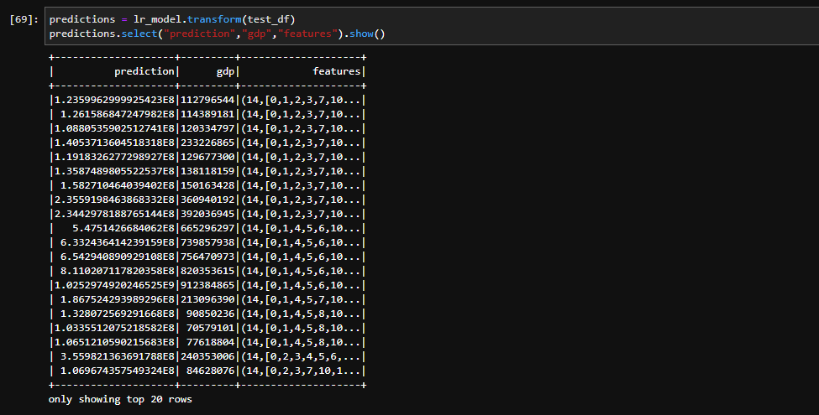
Models Constructed
Notes:
This is a quick prediction results using this model.

Slide 33
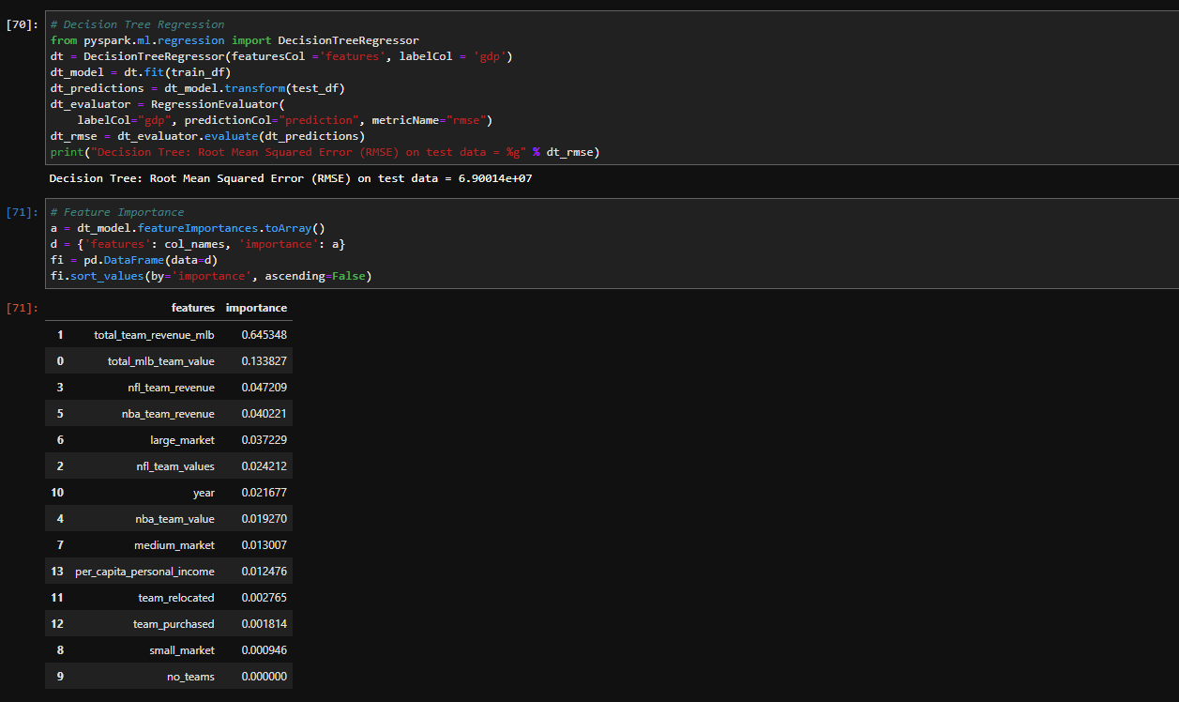
Models Constructed
Notes:
Then we moved on to the decision tree regression. We measured the feature importance to determine which feature seemed to be the most important one.

Slide 34
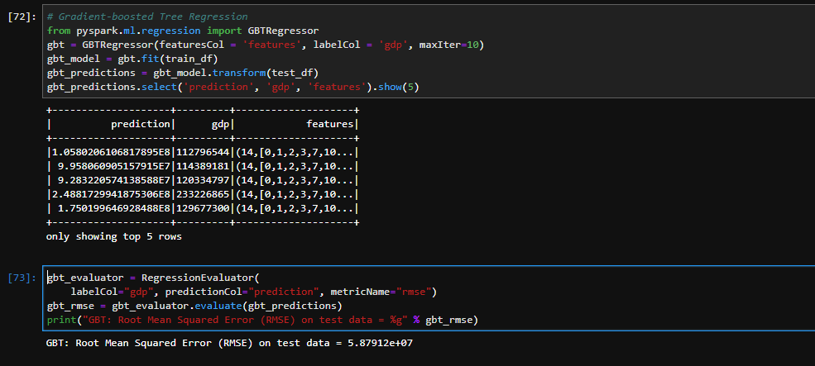
Models Constructed
Notes:
Finally, we trained gradient-boosted tree regression model and measured RMSE.

Slide 35
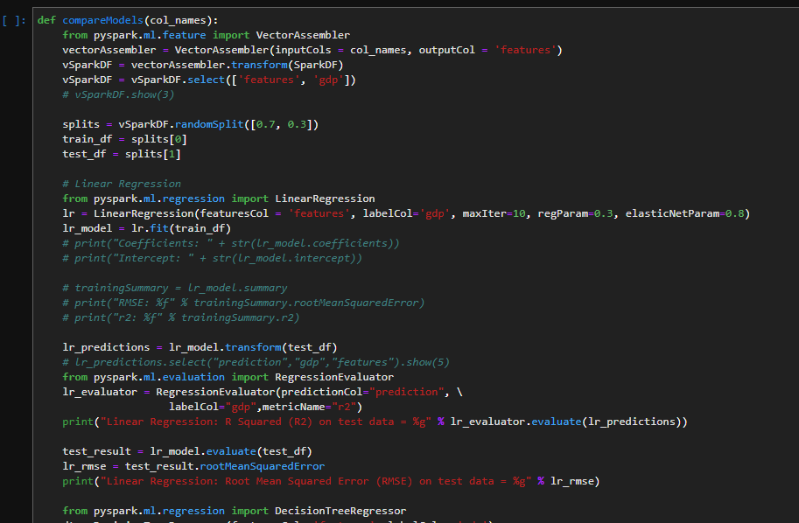
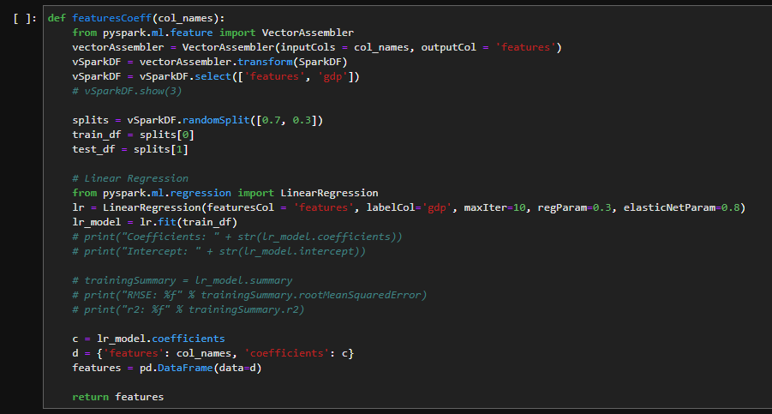
Models Constructed
Notes:
We compiled the codes I just ran through and wrote a function to compare all three models quickly with selected variables in terms of R-squared and Root Mean Square Error.

Slide 36
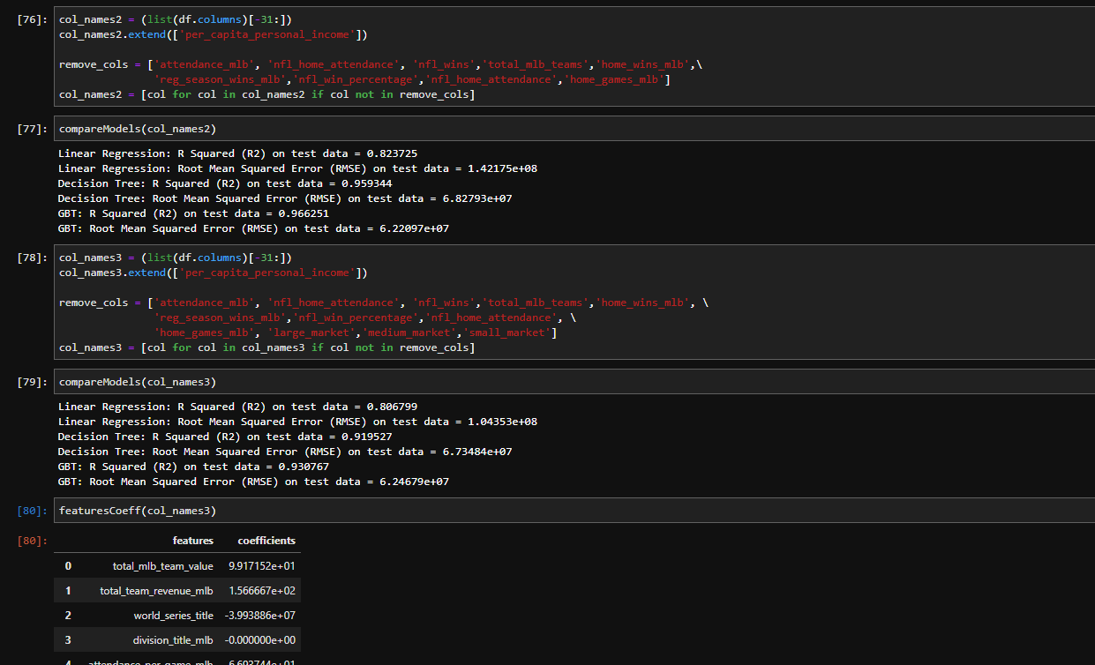
Models Constructed
Notes:
This is what it looks like in use.

Slide 37
Model Performance
Once our first model, Sports Teams effect on GDP, was developed the other two fell into place rather easy
Initially gave an amazing adjusted R-squared of 0.970195 as expected
After removing this nuclear variable we achieved a much more realistic, but sufficient results with an adjusted R-squared of 0.837875.
Noted the positive coef of “large_market” and “no_team”

Slide 38
Model Performance
Our second model focused on the impact market size played
This returned only one positive coefficient being “Large_Market” at 3.64e+08
“Small_Market” at -1.72e+08
“Medium_Market” at -1.87e+07
“No_Team” at -1.92e+08
Our last model looked at the ownership changed or initialization of a team.
Focusing on the binary variables “team_relocated” and “team_ownership”
Adjusted R-squared of 0.806118
root mean squared error of 1.04525e+08.

Slide 39
Conclusion and Future Research
Ultimately we concluded a city having a sports team can impact GDP, but only when market size is large such as New York City or Los Angeles.
We were also able to conclude that a team relocating or joining a league during its first year actually had a negative impact on GDP.
The change in ownership also had a slight negative impact on GDP however it was much less than the initialization of a team or relocation.

Slide 40
Conclusion and Future Research
Does it make economic sense for a city to recruit a professional sports team or an additional sports team to their market; is the return on investment there?
Does it have an impact on things that aren’t as easy to measure such as happiness of the residents and social opportunities?
Researching the localized effect of sports teams on restaurants and bars.
What impact does college sports have on their localities?

